Slide 1
Refugee Movement Around the World
Ishani Cheshire, Sarah Farooq, Nichol Flowers, Alex Lewis

Slide 2
Overview
01
02
03
04
05
06
Project Introduction
Redis & MongoDB
Neo4j
Page Rank
Degree Centrality
Shortest Path
Min. Spanning Tree

Slide 3

Introduction
Supporting smarter refugee aid planning and migration policy.
Goal
  Uncover key refugee flow patterns using graph analytics
Approach
  Model refugee flows with Neo4j
  Use graph algorithms to find influential countries and transit routes
Notes:
Our organization, Global Refugee Insights, works to support smarter refugee aid planning and migration policy around the world. We’re interested in uncovering meaningful patterns in refugee movements and identifying the most influential countries in these networks. To do this, we built a graph database in Neo4j where countries are nodes and refugee flows are edges. We applied several graph algorithms to better understand global migration dynamics—like which countries serve as major hubs or complex transit points. By comparing data over time, we’re able to highlight evolving trends and provide insights that give humanitarian organizations, governments, and policy planners the tools to act more effectively.

Slide 4

MongoDB
Storing Refugee Profiles and Case Histories
Flexible, document-based NoSQL database
Ideal for diverse, evolving refugee records
Handles inconsistent data across regions
Supports real-time updates and schema changes
Simpler than relational DBs with no complex joins

Slide 5

Redis
Real-Time Tracking and Monitoring Dashboards
In-memory key-value store optimized for speed
Real-time border crossing alerts and dashboards
Tracks live supply counts (beds, meals, supplies)
Instant updates for time-sensitive scenarios
Outperforms relational DBs in real-time use
Notes:
Store Min Spanning tree

Slide 6
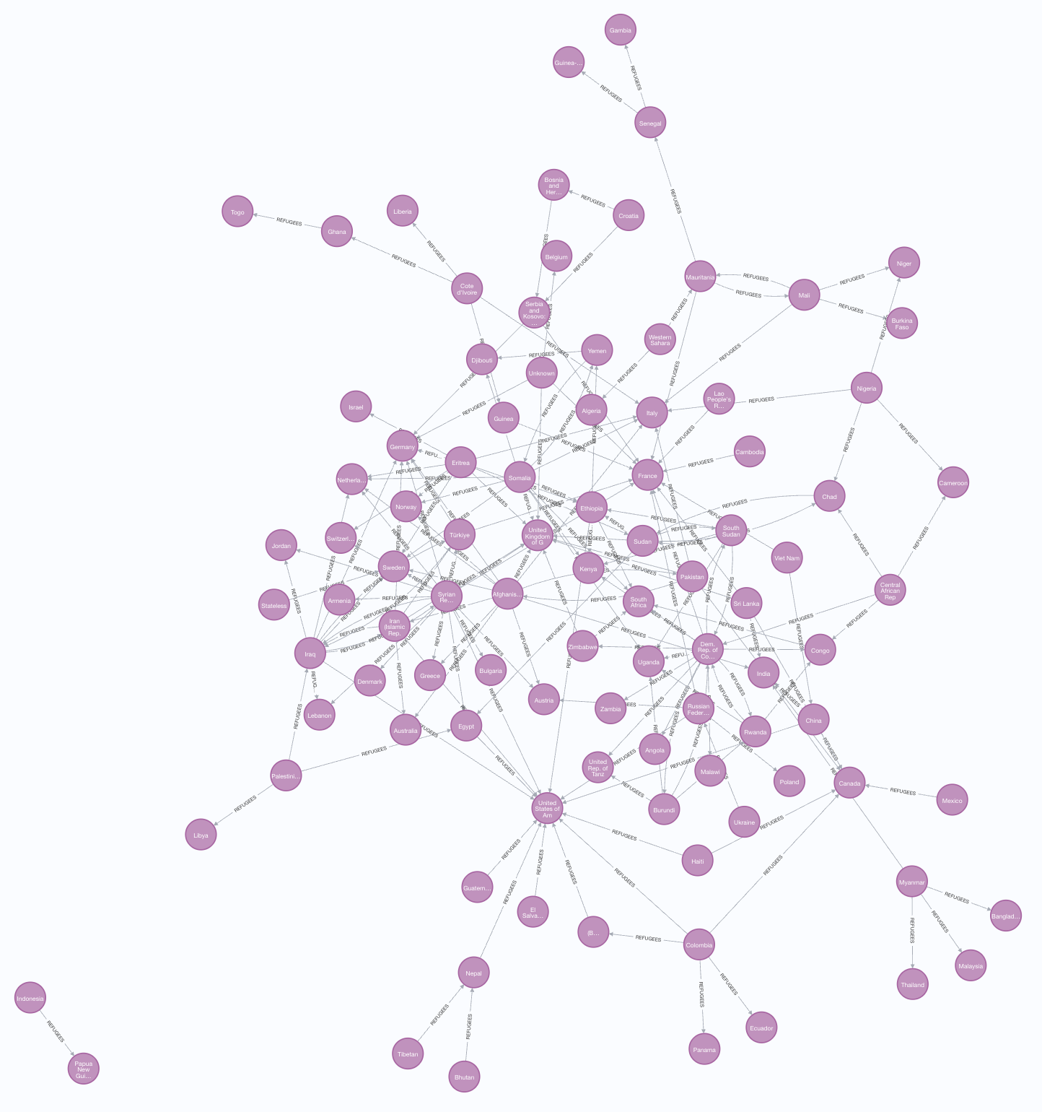
Neo4j
Analyzing Refugee Movement Around the World
Countries as nodes, refugee flows as directed, weighted edges
Captures complex migration patterns from origin to asylum
Enables analysis with graph algorithms
More effective than relational databases for network analysis
Notes:
Store Min Spanning tree

Slide 7
What is Page Rank?
Depth & Damping factor
Notes:
what is page rank?
origin
what it calculates
most influential—most pointers to it
more infuential pages have more weight in deciding the influences of the pages they point to
our settings (depth=20 and dampening=0.05) and what those mean
depth = how many nodes away we will consider. dampening = probability of jumping away / ending web surf session

Slide 8
Page Rank in Our Context
How to interpret a ‘high-influence’ country?
Primary Refugee Recipients
(TWO DIFFERENT GRAPHS)
Primary Refugee Producers
Major Entry Points
Transit Countries
Primary Refugee Producers
(TWO DIFFERENT GRAPHS)
Primary Refugee Recipients
Notes:
get rid of amjor entry points and transit countries?
It measures how popular (or connected) a node is within a network by counting how many connections it has. This means it helps pinpoint which locations are most involved in refugee flows. These high-degree nodes can represent major entry points, transit countries, or regions that serve as primary recipients of refugees.
They can be crucial for planning where to focus resource allocation, safety measures and support services tailored to the movement patterns.
what does page rank mean in our context?
different for COA vs COO
result for all years
interpretation
ex: result for 2015
hieght of syrian refugee crisis
reflected in data
we were also interested in change over time
again we can see a spike for the syrian refugee crisis
dominant USA almost all, prompting us to shift our focus
https://www.youtube.com/watch?v=meonLcN7LD4
10 minute presentaion
so this part should be 2.5 minutes
__Insert bar graphs — can you maek them interactive? Over the time period

Slide 9
OVERALL PAGE RANK
Two graphs:
country of origin
↓
country of asylum
country of origin
↑
country of asylum

Slide 10
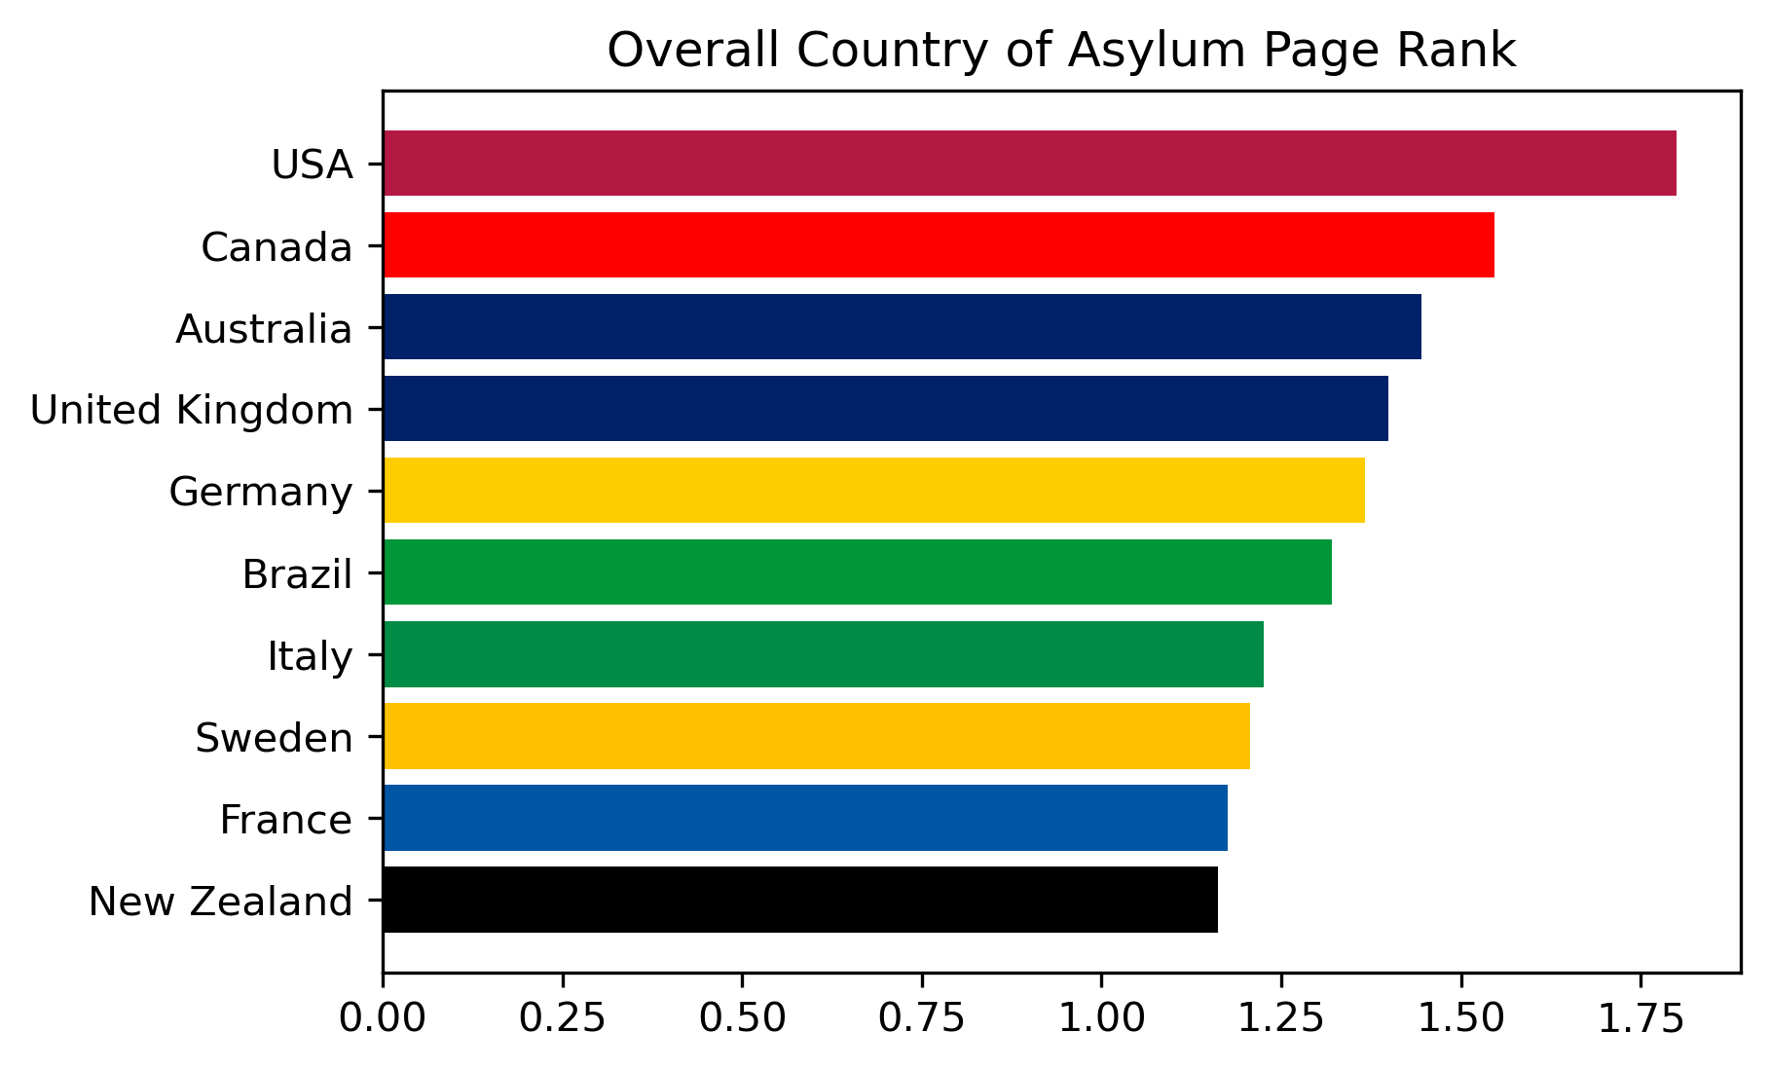
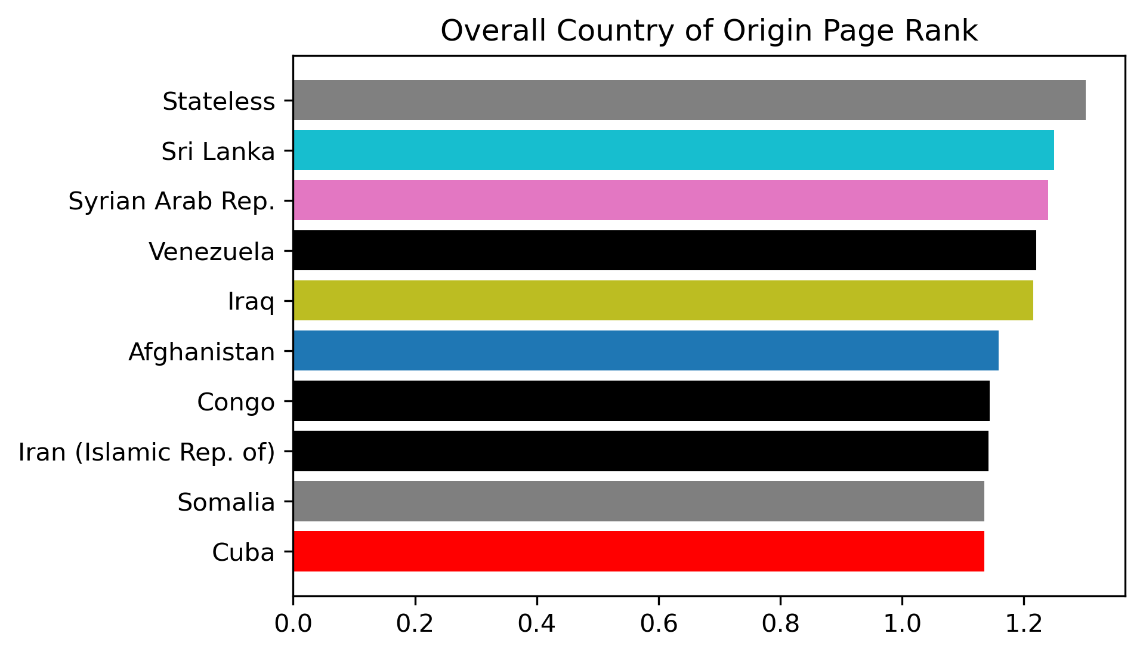
OVERALL - PAGE RANK
COUNTRIES OF ASYLUM
COUNTRIES OF ORIGIN

Slide 11
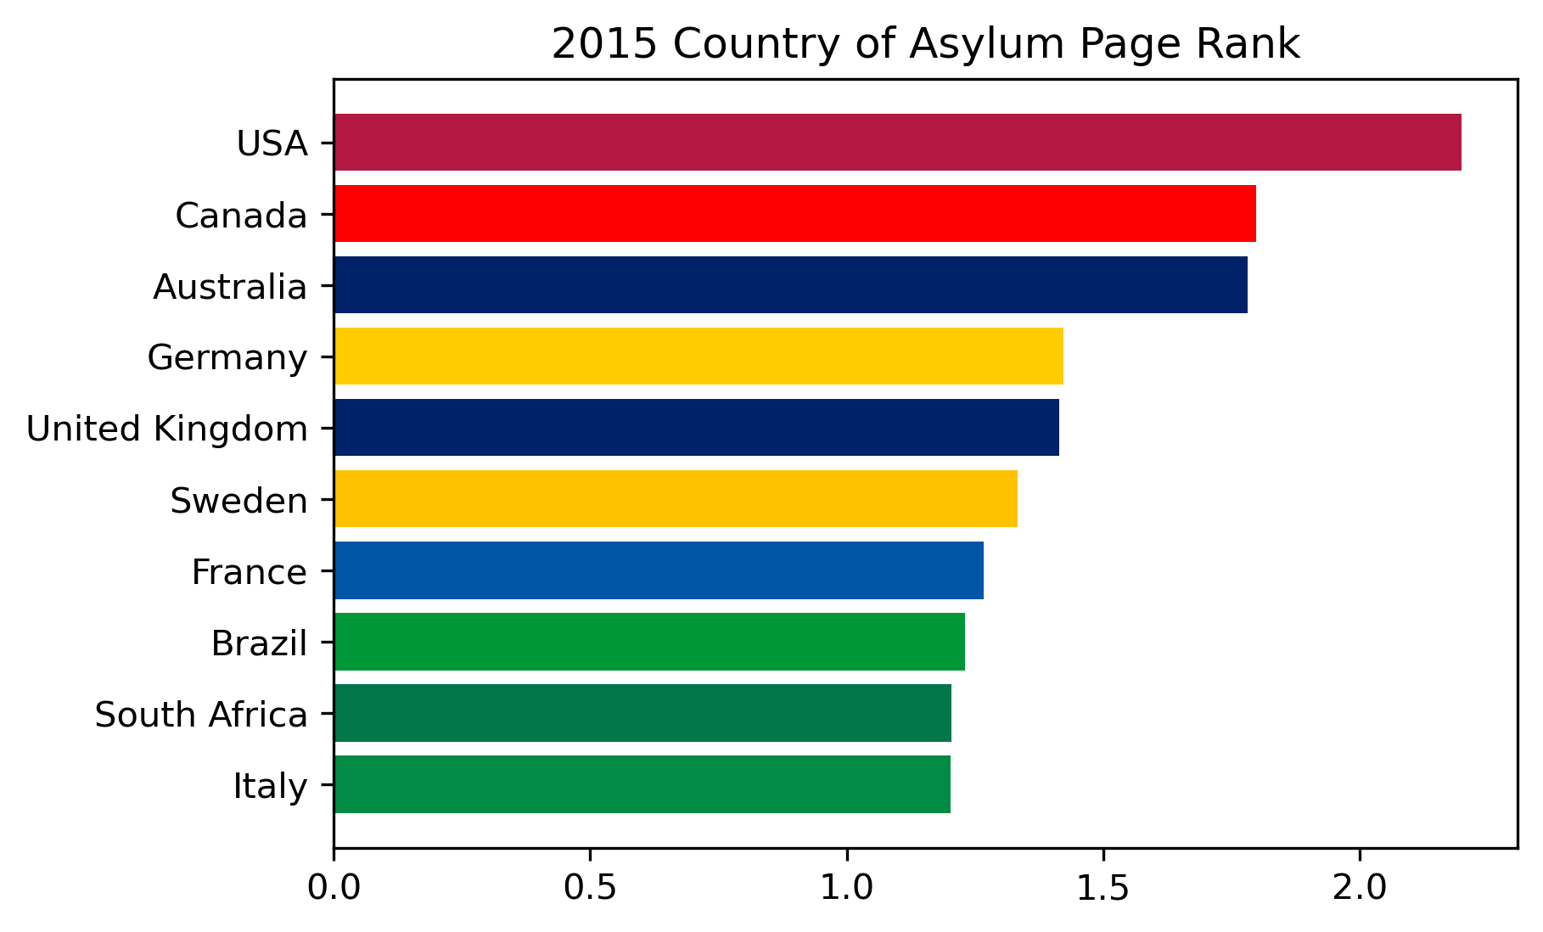
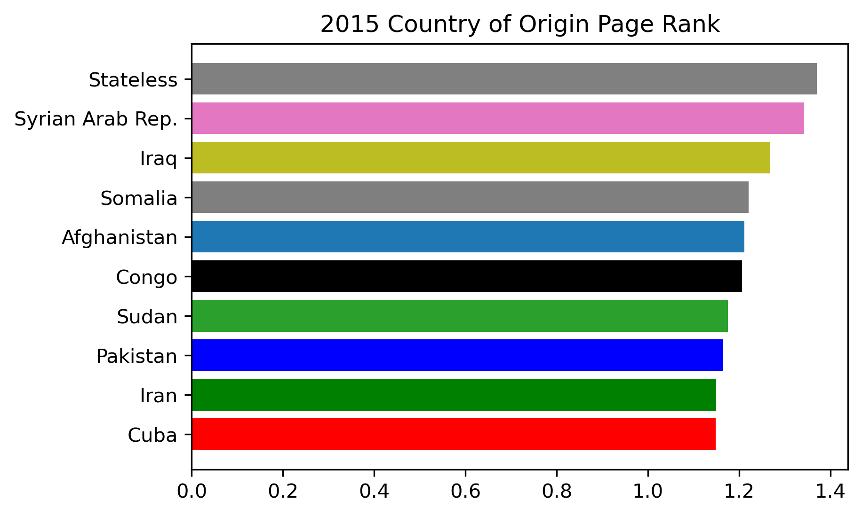
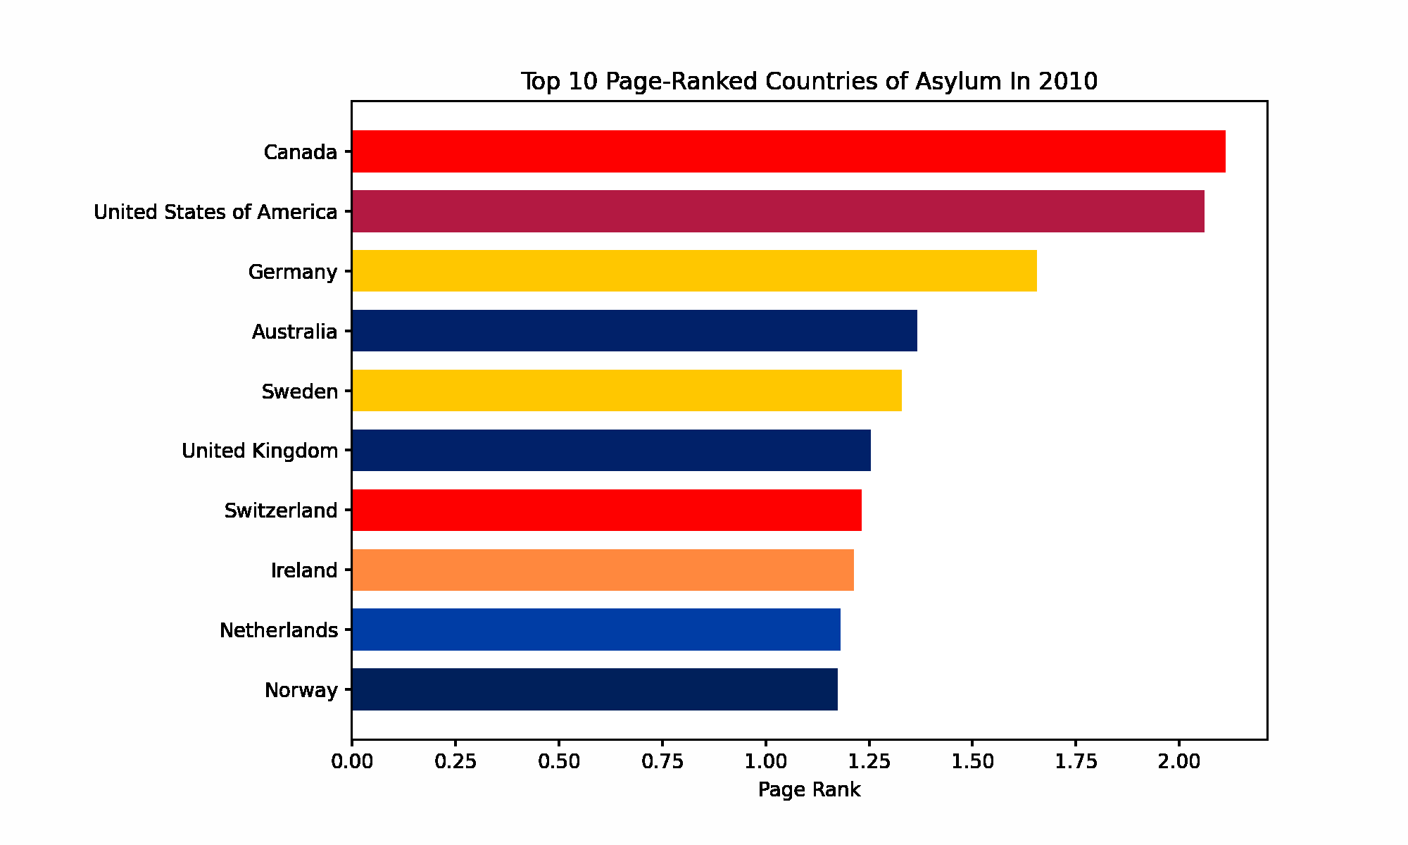
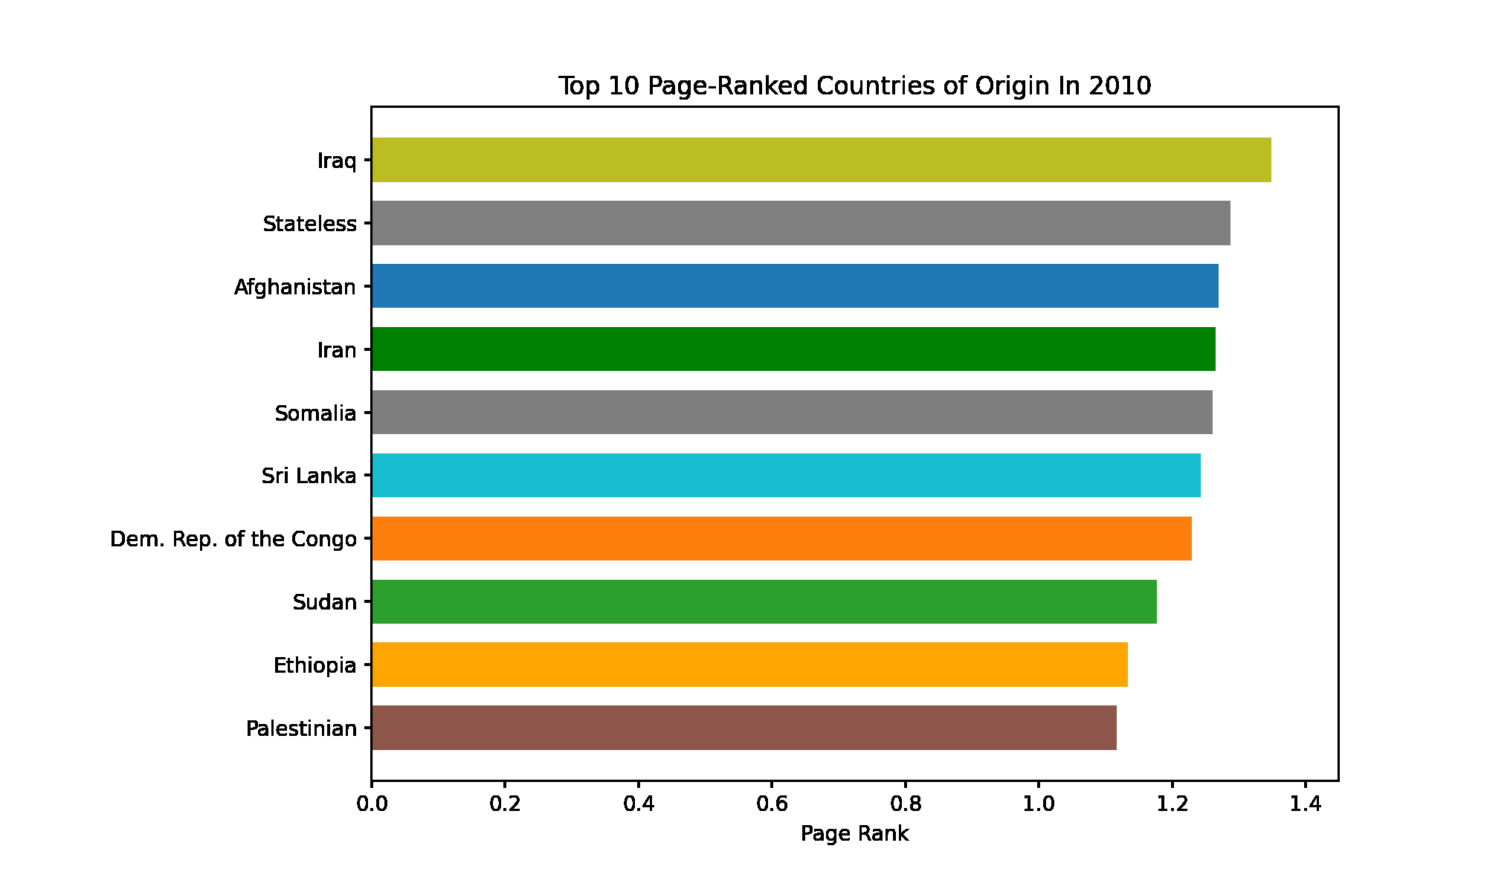
2015 - PAGE RANK
COUNTRIES OF ASYLUM
COUNTRIES OF ORIGIN

Slide 12
OVER TIME - PAGE RANK
COUNTRIES OF ASYLUM
COUNTRIES OF ORIGIN

Slide 13
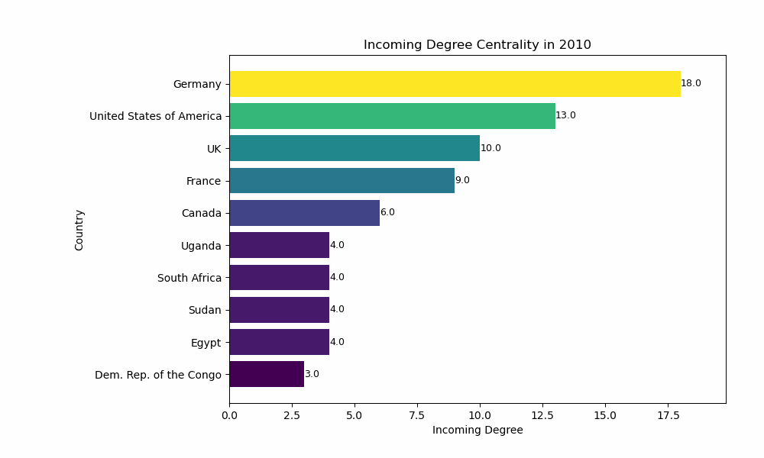
Degree Centrality - Incoming (2010/2015/2020)
2015
Venus has a beautiful name and is the second planet from the Sun
Notes:
Degree centrality measures how connected a country is within a network by counting how many relationships it has.
This chart shows INcoming Degree Centrality, which is the asylum-granting countries have the largest number of relationships. Countries like Germany, the United States, and the UK consistently rank at the top across all three years, indicating that they were connected to a wide range of refugee origin countries throughout the decade. While some European and North American countries remained global hubs, African nations like Uganda and South Africa also appeared consistently, reflecting their role as regional hosts. These patterns highlight both global and regional asylum destinations that are structurally central to refugee flows over time.
—----------------------------------------------------------------------------------------
The United States consistently ranks in the top two across all three years, highlighting its central role in receiving refugees from a broad set of origin countries.
NTS:
It measures how popular (or connected) a node is within a network by counting how many connections it has. This means it helps pinpoint which locations are most involved in refugee flows. These high-degree nodes can represent major entry points, transit countries, or regions that serve as primary recipients of refugees and They can be crucial for planning where to focus resource allocation, safety measures and support services tailored to the movement patterns.

Slide 14
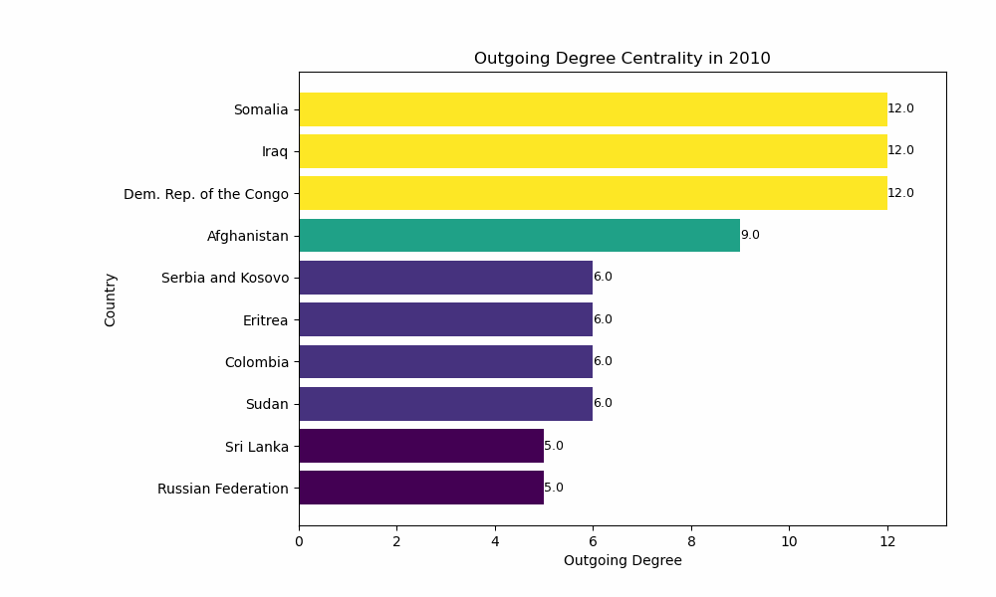
Degree Centrality - Outgoing (2010/2015/2020)
2015
Venus has a beautiful name and is the second planet from the Sun
Notes:
This chart shows OUTgoing Degree Centrality for the same years and it highlights the refugee-origin countries with the largest number of distinct outbound connections to other nations.
Countries like Somalia, Iraq, Afghanistan, and the Democratic Republic of the Congo consistently have high outgoing degree centrality, meaning they sent refugees to a wide range of other countries over time. In later years, countries like Syria and Venezuela rise in prominence, signaling the emergence of new or intensifying conflicts driving large-scale, multi-destination refugee flows.
—--------------------------------------------------------------------------------------------------------------------------------------------------------------------------------------------------------------------------------------------
Outgoing degree centrality measures how many outgoing relationships a country of origin (COO) has in the refugee network — that is, how many distinct countries it sends refugees to. A high outgoing degree indicates that displacement from that country is widespread, reaching many asylum destinations across the network.
NTS
Countries like Somalia, Iraq, Afghanistan, and the Democratic Republic of the Congo consistently rank high in outgoing degree centrality across all three years.
It measures how popular (or connected) a node is within a network by counting how many connections it has. This means it helps pinpoint which locations are most involved in refugee flows. These high-degree nodes can represent major entry points, transit countries, or regions that serve as primary recipients of refugees and They can be crucial for planning where to focus resource allocation, safety measures and support services tailored to the movement patterns.

Slide 15
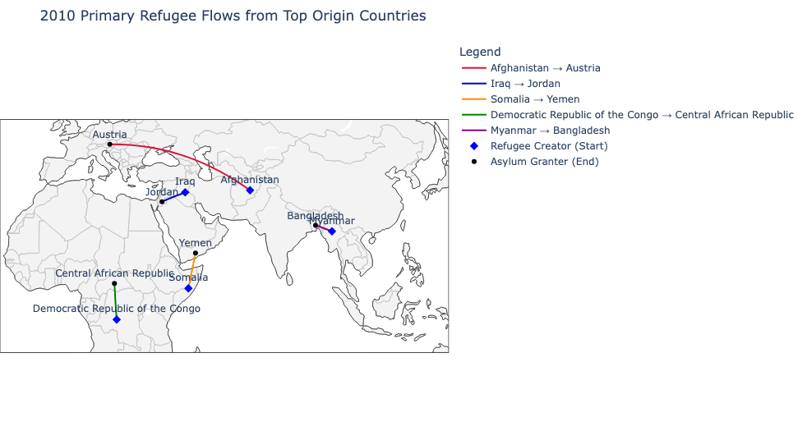
Min. Spanning Tree 2010
Notes:
A minimum spanning tree (MST) shows the most efficient way to connect all points in a network without creating any loops.
This map shows the main refugee paths in 2010 from the top five origin countries, based on the minimum spanning tree of the network. It highlights the strongest connection each country had to an asylum destination that year.
NTS: Min spanning trees connect all points (without cycles/loops) with the smallest total cost.<<What is our cost based on? Safety, distance?>> They help identify the most efficient ways to connect key locations(like shelters, supply centers, or transit routes) which is vital for planning logistics and resource distribution for refugees.

Slide 16
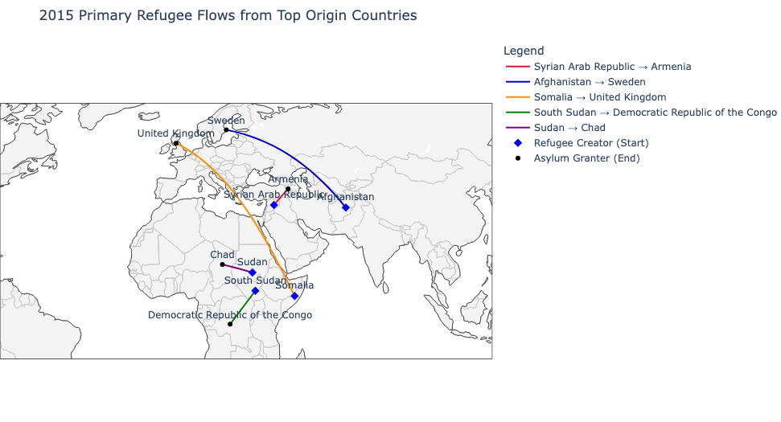
Min. Spanning Tree 2015
Notes:
This map shows the primary refugee flows in 2015 from the top five origin countries. Unlike 2010, several paths—such as Afghanistan to Sweden and Somalia to the United Kingdom—reflect long-distance displacement, highlighting Europe’s role as a key asylum destination during that year.
NST: Min spanning trees connect all points (without cycles/loops) with the smallest total cost.<<What is our cost based on? Safety, distance?>> They help identify the most efficient ways to connect key locations(like shelters, supply centers, or transit routes) which is vital for planning logistics and resource distribution for refugees.

Slide 17
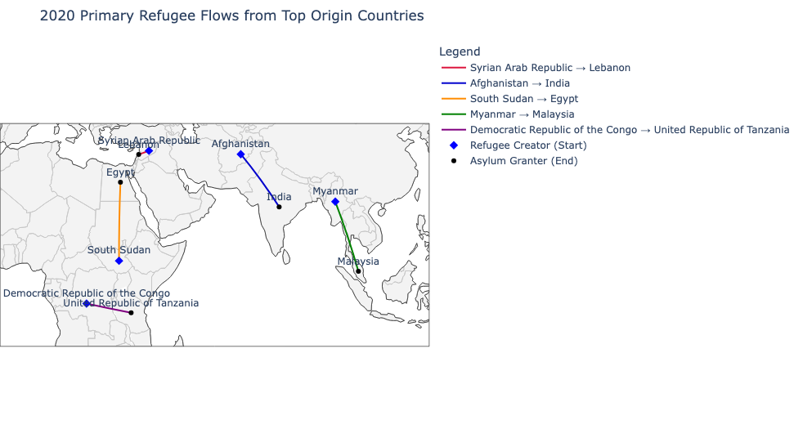
Min. Spanning Tree 2020
Notes:
This map shows the primary refugee paths in 2020 from the top five origin countries, with each line representing the most direct or dominant connection to a country of asylum. Most movement remained regional, such as South Sudan to Egypt and Myanmar (mee-ahn-mar) to Malaysia, highlighting proximity as a key factor in displacement patterns.
Trends across the 3 years
Shift in Asylum Destinations
In 2010, flows were often regional—e.g., Somalia to Yemen, Myanmar to Bangladesh.
By 2015, more routes extend to Europe (e.g., Afghanistan to Sweden, Somalia to the UK), suggesting a broader geographic spread in asylum destinations.
In 2020, the flows appear to return more to regional neighbors (e.g., DRC to Tanzania, South Sudan to Egypt), possibly due to tightened European borders or changing global policies.
Increasing Role of Africa and Asia
While Europe shows up strongly in 2015, most movements across all years involve African or Asian countries, emphasizing that neighboring countries bear much of the burden of displacement.
NTS - Min spanning trees connect all points (without cycles/loops) with the smallest total cost.<<What is our cost based on? Safety, distance?>> They help identify the most efficient ways to connect key locations(like shelters, supply centers, or transit routes) which is vital for planning logistics and resource distribution for refugees.

Slide 18
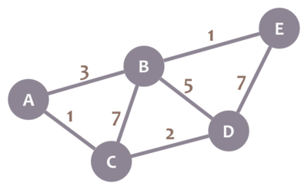
Shortest Path
Determine how direct or indirect refugee movements are, particularly towards the U.S.A.
Page Rank → Top 5 Countries of Origin for 2010, 2015, and 2020
Dijkstra's Algorithm → Find shortest path from each COO to U.S.A. by minimizing cost and number of intermediate countries
Help operational aid planning, policy targeting, and refugee support
Notes:
Our last algorithm was Shortest Path, which we used to analyze how direct or indirect refugee movements are—especially towards the United States. With PageRank identifying the top country of asylum across multiple years as the U.S., we applied Dijkstra’s Algorithm to find the shortest and most efficient path from the top 5 countries of origin in 2010, 2015, and 2020 to the U.S. to analyze trends over time Using this algorithm would minimize both the cost and the number of intermediate countries. This analysis helps inform aid distribution, policy targeting, and refugee support planning by identifying potentially high-cost or high-risk journeys.

Slide 19
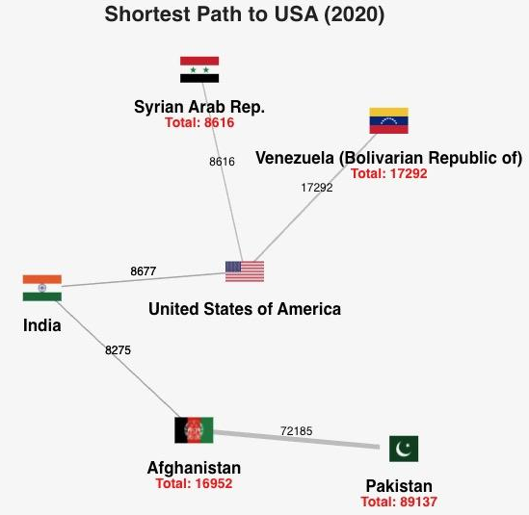
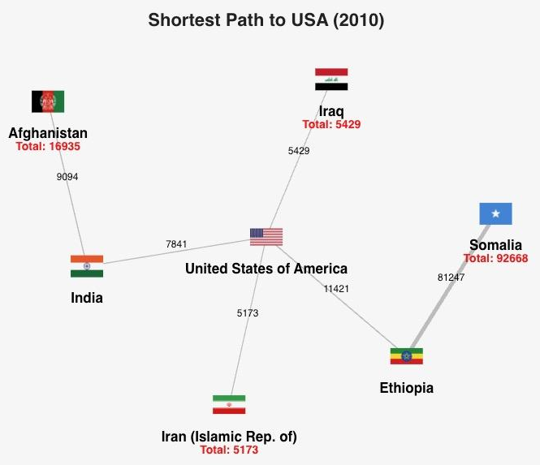
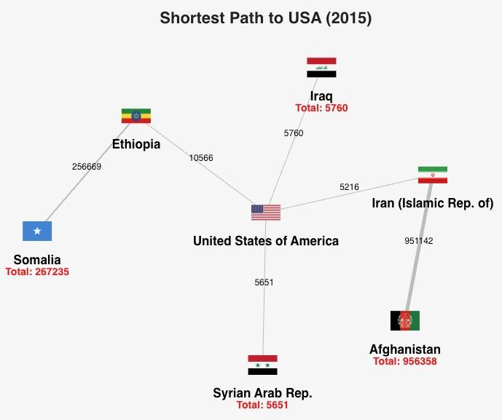
Shortest Path
Stateless
Total: 0
Stateless
Total: 0
Stateless
Total: 0
Notes:
When we applied the Shortest Path algorithm across 2010, 2015, and 2020, some clear patterns emerged. Stateless populations consistently had no direct path to the United States, highlighting their unique and persistent challenges in the resettlement system. On the other hand, countries like Syria, Iraq, and Venezuela had direct paths to the U.S., suggesting strong, possibly bilateral resettlement relationships. In contrast, we saw that refugees from countries like Somalia, Afghanistan, and Pakistan often had to pass through multiple countries. These longer routes imply greater transit and logistical obstacles—factors that could affect both safety and policy planning. These findings give us insight into the complexity and unevenness of refugee movement across different regions and time periods.

Slide 20
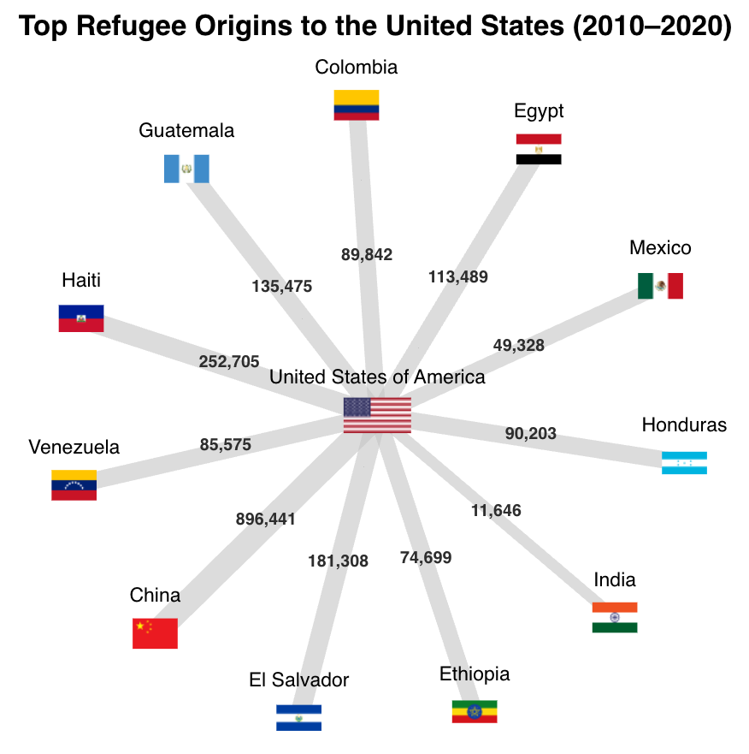
Conclusion
Notes:
To wrap up, our findings show that the U.S. consistently ranked as the most influential asylum country—across PageRank, degree centrality, minimum spanning tree, and shortest paths. This made it the central focus of our analysis. We saw key global hubs like Germany and the UK, along with regional hosts like Uganda. Countries such as Somalia and Iraq drove wide-reaching refugee flows, while Syria and Venezuela rose in prominence later. In 2015, Europe saw more long-distance movement, whereas by 2020, displacement became more regional. Stateless populations had no clear paths, highlighting unique vulnerabilities. Together, these insights can help guide smarter humanitarian and policy responses.

Slide 21
THANK YOU

